Slide 1
Welding Manipulators Path Planning
R36094189 Yu-En Shen
Notes:
Good afternoon, teacher and classmates. I’m Yu-En Shen, today I will introduce about my project.
My topic is about planning the path of the welding manipulators in car production line.

Slide 2
CONTENTS
01
Problem Description
02
Parameters & Variables
03
Model Design
04
Results
Notes:
My presentation has four chapters.
The first is to describe problem
The following chapter will introduce about the problem in reality and some parameters and variables.
Then I will introduce the model design and conclude the presentation.
Finally show the result solved by gurobi

Slide 3
01
Problem Description
Notes:
The next chapter is problem description.

Slide 4
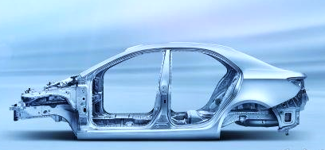
Problem Description
Introduction about this problem
Welding points around a car
Notes:
I want to make manipulators welding car shell.
There are many welding points around a car, and we need to weld all points.
Because different manipulators can weld at the same time, our objective is to minimize the max processing time of manipulators, instead of the total processing time

Slide 5
Problem Description
Introduction about this problem
Welding points around a car
Original site of
manipulators
Notes:
They are welding points of car shell.
And there is a fixed starting point of manipulators.

Slide 6
Problem Description
One feasible solution
Introduction about this problem
Notes:
If there are three manipulators, this is a possible path plan.

Slide 7
Problem Description
Another feasible solution
Introduction about this problem
Notes:
And so does it.
But in this case we can find the blue one welding more points so that it may consume more time to weld.
In contrast, the green one welds few points, it may finish it’s task early and just wait for the blue one.
So it’s not a good path because the max total processing time depends on the max one.

Slide 8
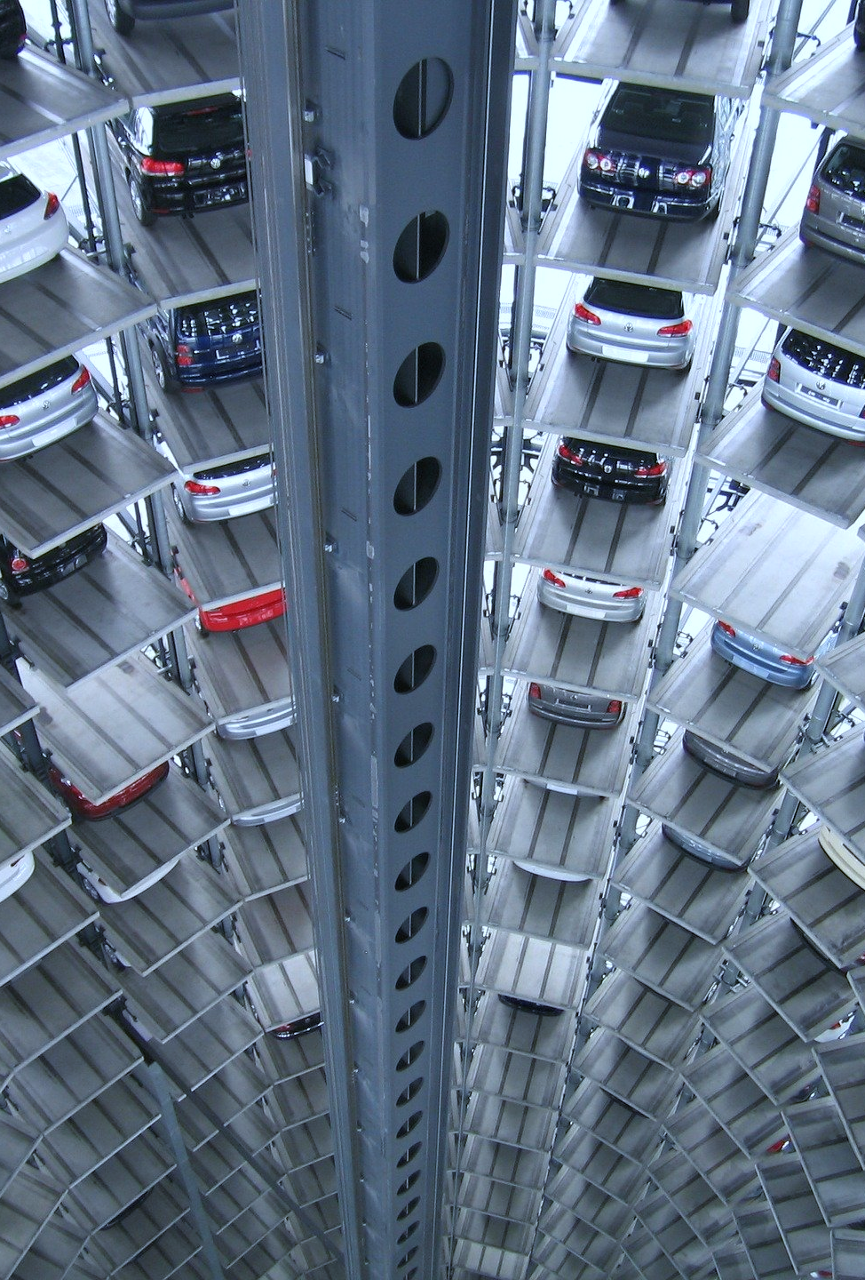
Problem Description
The information we already know
１
There are three manipulators can weld points
Collision cases should be avoided
２
The total number and positions of welding points
All points should be welded once
３
The moving path between each two points are fixed
We can get the travel time between each two points
Notes:
This is the information we already know.
There are 3 manipulators, and each of them has fixed processing range. We should avoid the collision cases.
And then there are fixed welding points, and all of them should be welded.
If we decide to move from point i to point j, there is a fixed moving path.

Slide 9
02
Parameters & Variables
Notes:
The following is parameters and variables

Slide 10
Parameters & Variables
Limitation of problem in real world
Objective is to minimize the max processing time, including the travel time and welding time
One point can be welded once
One manipulator can weld one point at once
One manipulator can have only one route
Collisions are not allowed
Notes:
Before introducing the setting, there are some thing we need to notice.
One point can be welded once
One manipulator can weld one point at once
One manipulator can have only one route
Collisions are not allowed

Slide 11
Parameters & Variables
Sets, variables and parameters
Sets
Node : the welding points
Node : all nodes which contains welding points and original point
Arc : possible edges between nodes i and j
Manipulator : the manipulators
Level space : the level spaces 1 to n
Level space : the level spaces 0 to n, which contains starting level
i
i'
Cross edge : crossed edge and
j'
j
Notes:
Base on the limitations, I define these sets.
Nodes are welding points, and possible paths between edge(i, j) belong to set A.
Manipulator and level space respectively belong to set K and set L.
Set R(i) and set N(k) are designed to make the model more efficient.

Slide 12
Variables
Parameters & Variables
Sets, variables and parameters
Whether manipulator k is welding point i at level l or not:
If it is welding, ; otherwise,
Whether an edge (i, j) is gone through by manipulator k at level l or not:
If it is gone through, ; otherwise,
Starting time of edge of manipulator k at level l:
Ending time of edge of manipulator k at level l:
Whether time of manipulator k at level l and k’ at level l’ is crossed or not:
If it is crossed, ; otherwise,
Parameters
Travel time between node i and j :
Welding time at node i :
Notes:
I use variable xilk to express whether manipulator k is welding point i at level l or not
And variable yijlk to express whether an arc (i, j) is gone through by manipulator k at level l or not
Because we want to avoid the collision case, the time should be taken into consideration.
And the parameters we already know are travel time of each edge and welding time of each node.

Slide 13
03
Model Design
Notes:
The following is model constraints

Slide 14
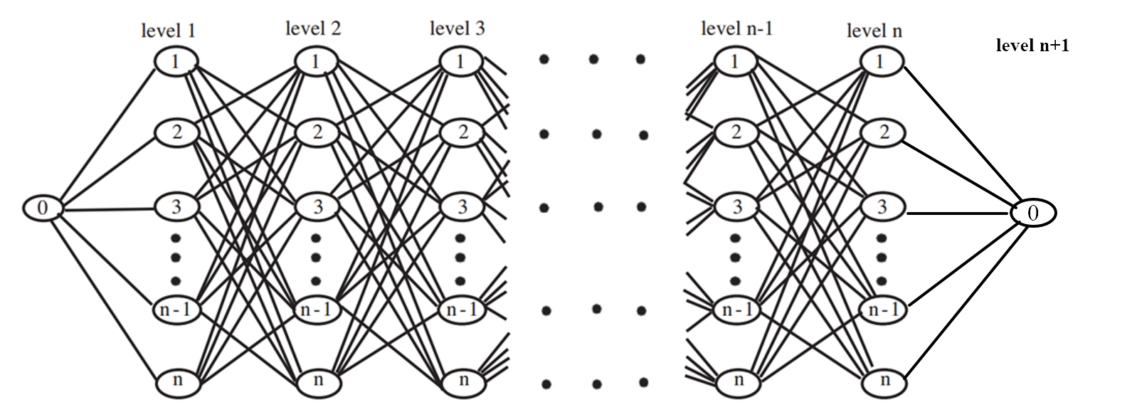
Model Design
Level space
Case for 1 manipulator :
Level 0
Level 1
Level 2
Level 3
Level n-1
Level n
Level n+1

Slide 15
Model Design
No Crossed with
Time Relaxed Model
No Crossed Model
4
4
1
10
10
1
2
6
2
6
8
8
5
9
5
9
7
3
7
3
-1
-1

Slide 16
No Crossed Model
Model Design
No crossed allowed
1
Max processing time
2
Start from 0
3
Welded once for points
4
Welding at most one point at each level for manipulators
5

Slide 17
No Crossed Model
Model Design
No crossed allowed
Each manipulator with one route
6
7
Other nodes
Node 0
Other nodes

Slide 18
No Crossed Model
Model Design
No crossed allowed
Flow balanced
8
9
Other nodes
Node i
Other nodes
i

Slide 19
No Crossed Model
Model Design
No crossed allowed
Flow balanced
8
9
Other nodes
Other nodes
i

Slide 20
No Crossed Model
Model Design
No crossed allowed
No crossed
10
i
i'
i
i
j
j'
j
i'
i'
j'
j
j'

Slide 21
No Crossed with Time Relaxed Model
Model Design
No Crossed with Time Relaxed Model
1
Max travel time
2
Start from 0
3
Welded once for points
4
Welding once each level for manipulators
5

Slide 22
No Crossed with Time Relaxed Model
Model Design
No crossed allowed
Each manipulator with one route
6
7
Flow balanced
8
9

Slide 23
No Crossed with Time Relaxed Model
Model Design
No crossed allowed
Ending time at level 0
10
Starting time
11
Ending time
12
0
3
1
2

Slide 24
No Crossed with Time Relaxed Model
Model Design
No crossed allowed
Whether time crossed
13

Slide 25
No Crossed with Time Relaxed Model
Model Design
No crossed allowed
Whether time crossed
14
i
i'
i
i'
i
j
j'
j'
i'
j
j
j'

Slide 26
04
Results
Notes:
This is the last chapter

Slide 27
Results
4
Crossed allowed model
10
1
2
6
8
5
9
3
7
Crossed Allow Model
-1
Opt = 128, running time = 101(s)

Slide 28
Results
4
No crossed model
1
10
2
6
8
5
9
3
7
No Crossed Model
-1
Opt = 130, running time = 181(s)

Slide 29
Results
4
No crossed with time relaxed model
10
1
2
6
8
5
9
3
7
No Crossed with Time Relaxed Model
-1
Opt = 128, running time = 374(s)

Slide 30
Crossed Allow Model
Conclusion
Opt = 128, running time = 101(s)
4
1
4
10
10
1
2
6
2
6
8
8
5
9
7
3
5
9
7
3
0
No Crossed Model
0
4
Opt = 130, running time = 181(s)
10
1
2
6
8
No Crossed with
Time Relaxed Model
5
9
7
3
Opt = 128, running time = 374(s)
0

Slide 31
Conclusion
Decreasing the processing time can raise up the production capacity per unit time, so that we can meet more demand to get more profit.
Notes:
The result of model can find the policy with least processing time.
Decreasing the processing time can raise up the production capacity per unit time, so that we can meet more demand to get more profit.

Slide 32
Thanks for listening
2020.12.28 Yu-En Shen
Notes:
This is my presentation
Thanks for listening

